Slide 1

Bhagwan Mahavir College Of Computer Application
Subject : Project PPT
Topic : Salon Management System
Guided by :
Asst.Prof.Kruti Patel
Presentnted by :
Sonani Darsh (2102020101802)
Sujal Mavani (2102020101508)
Savani Jeel (2102020101738)
Sojitra Tej (2102020101798)

Slide 2
Table Of Content
Acknowledgement
Project Defination
Tools and Technology Used
Section In Project
Admin
User
Visitor
Visitor Side Panel
Coman Pages
User Side Pages
Admin Side Pages
Limitation
Future Enhancement
Refrence
Thank You

Slide 3
Acknowledgement
Our self Darsh Sonani , Jeel Savani, Sujal Mavani And Tej Sojitra. We Have opportunity to express our knowledge. We would like to express our gratitude to all those who gave us the possibility to complete our project. We want to thanks to Bhagwan Mahavir College Of Computer Applicatio for giving us permission to do project work in their organization.

Slide 4
Project Defination
Maruti X is online Salon Shop through which user can Book Appoitment Online.
Maruti X (Online Salon store) offers Booking online Appoitment than going to Shop and stay in waiting.
Maruti X (Online Salon store) not only give information to Book Service but it also provides it at a Small price.

Slide 5
Tools and Technology Used
Frontend:
Html
Css
Js
BootStrap
Back-End
Node.js
Expreess.js
Sequelize

Slide 6
Section In Project
There are Three Section In our application:
Admin
User (Customer)
Visitor

Slide 7
Admin
Admin Can Login With Email And Password
Admin can add users ,See All Active users,deleteusers,retrive deleted users and see all past deleted users.
Admin can see all appoitment,delete appoitment,retrive deleted appoitment if deleted by admin and see all past deleted appointment.
Admin can add employee with name,image etc,aee all employee,update employee,delete employee,retrive deleted employee,see all past deleted employee.
Admin can see all review,delete review,retrive deleted review if deleted by him,see all past deleted review.

Slide 8
User
User Can Login With Email And Password
User can see all various type of appointment.and book appoitmnet for them.
User can see all appointment booked by him and delete them
User can add review and see their review and delete their review.
User can see all review.
User can see their profile.
User can update their profile.
User are allowed in all page.
User can see all employee.

Slide 9
Visitor
Visitor register with name,email,password.
Visitor can see all reviews.
Visitor can see all page.
Visitor can’t book appointment.
Visitor can see all employees.

Slide 10

Visitor Side Panel Home Page.

Slide 11
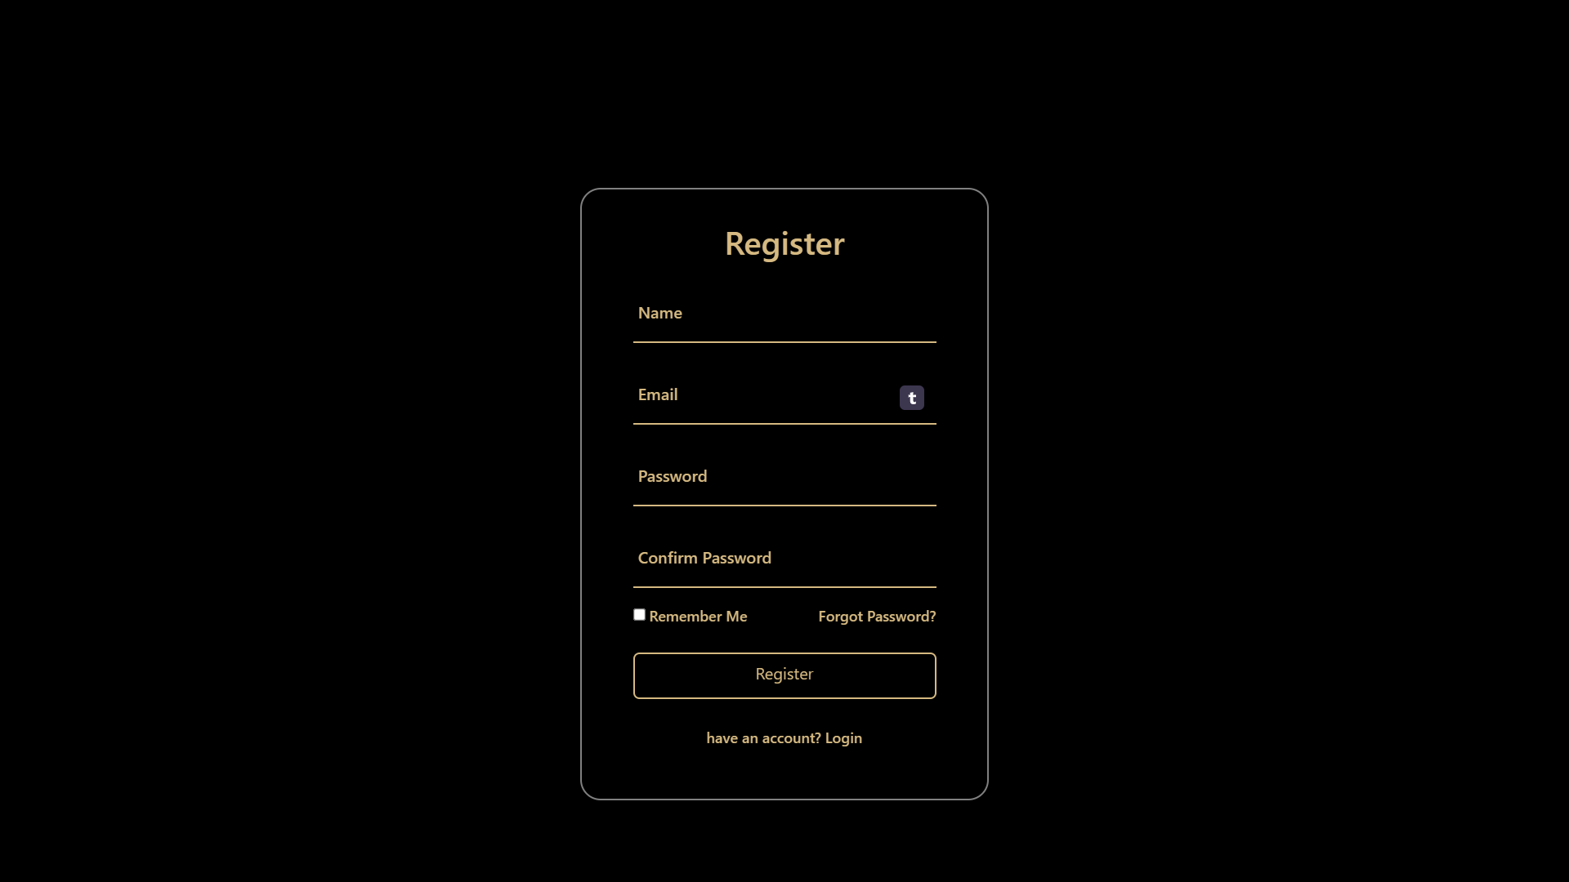
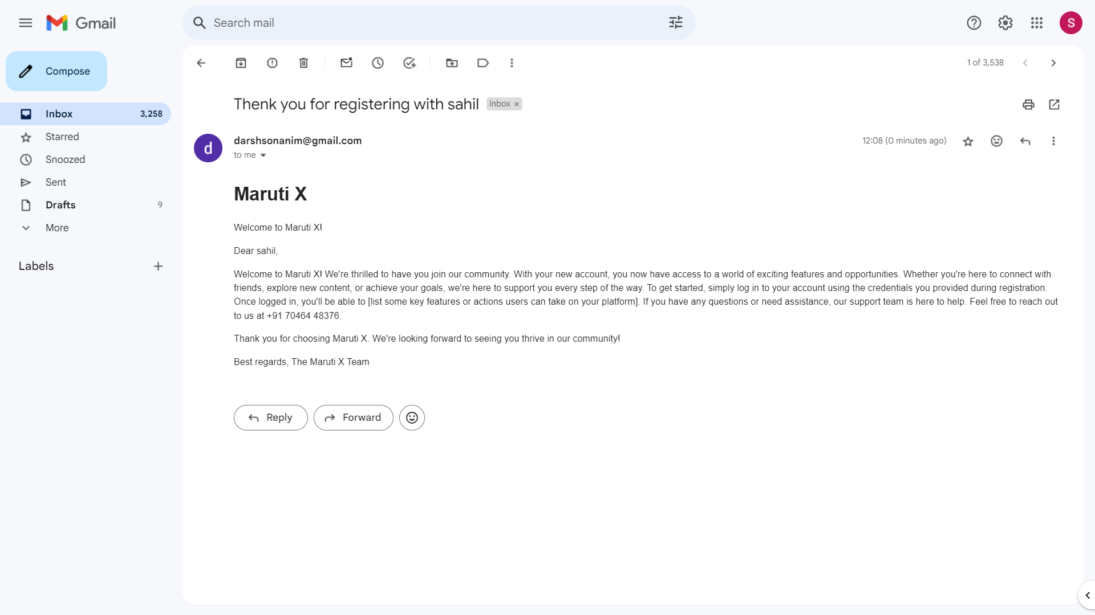
Visitor Side Panel Register Page.
Register
Email

Slide 12

Coman Pages About page.

Slide 13

Coman Pages Inside about page.

Slide 14
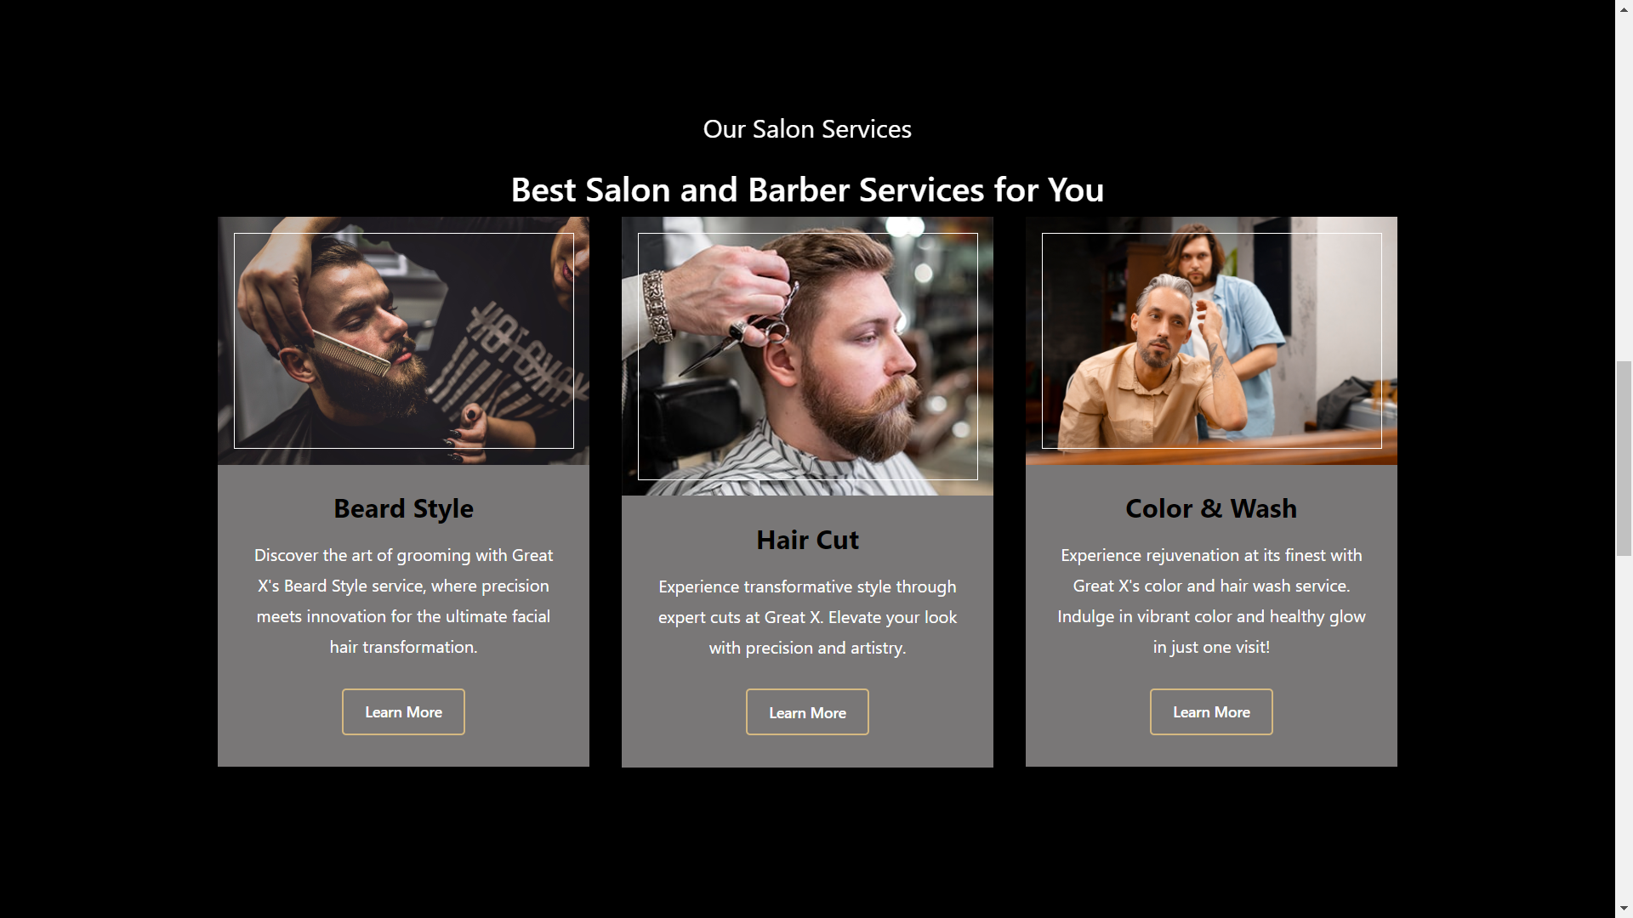
Coman Pages Our salon service.

Slide 15
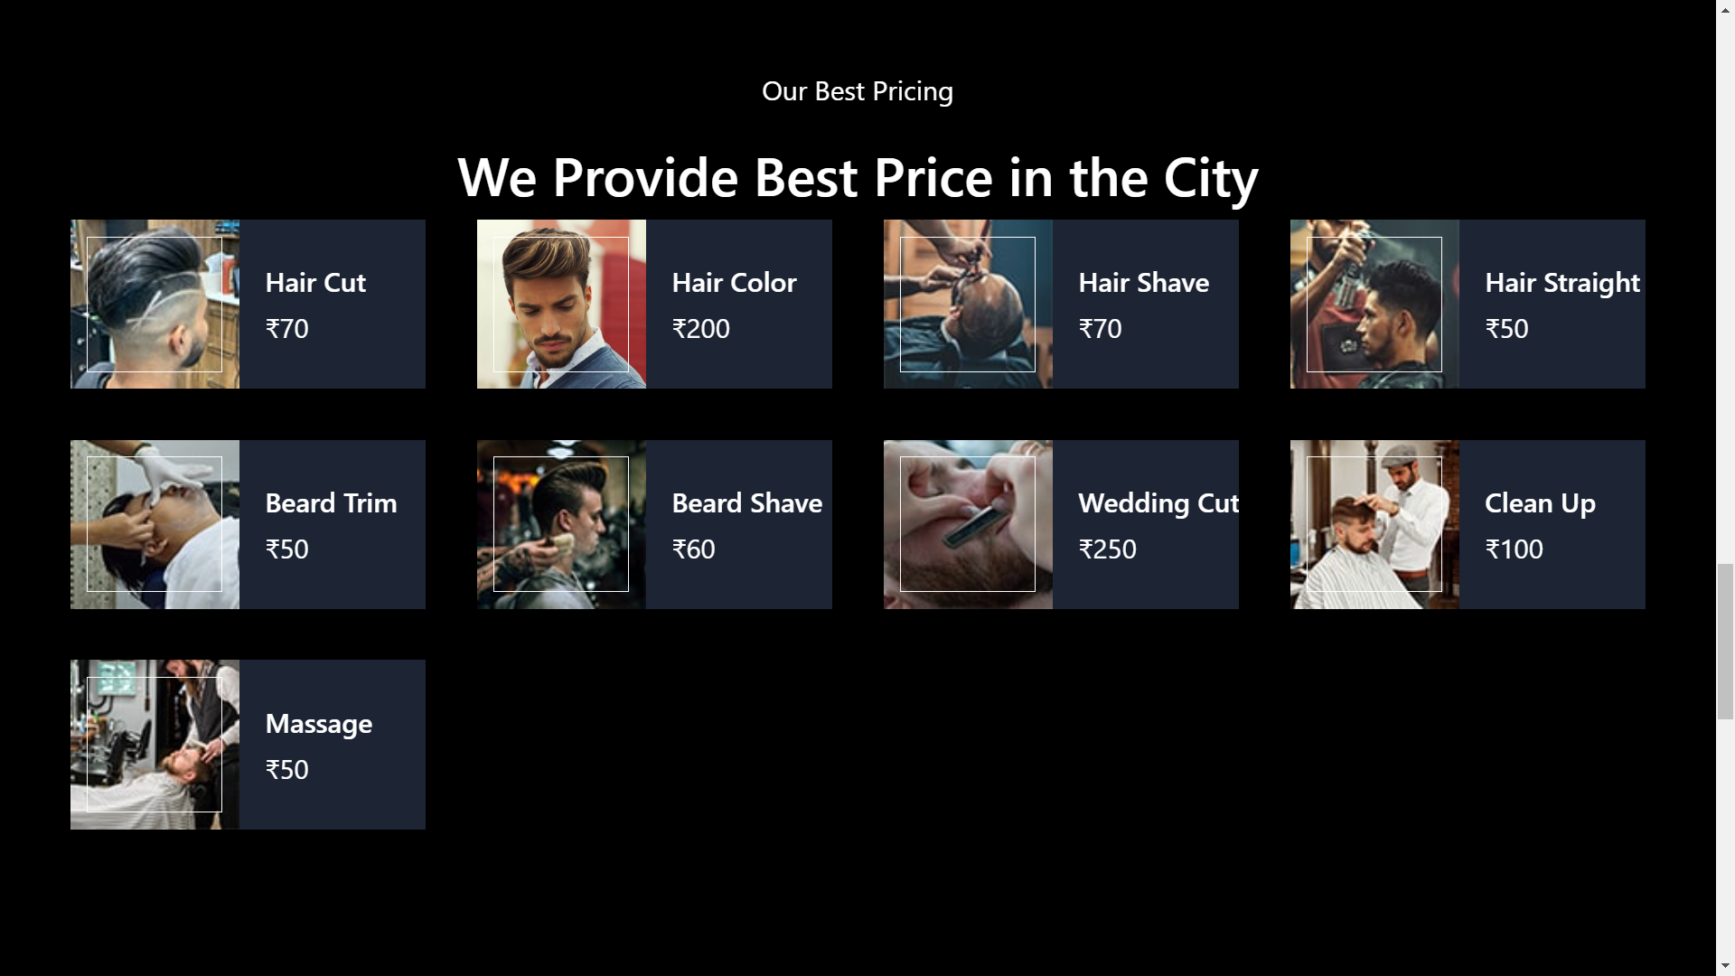
Coman Pages service.

Slide 16
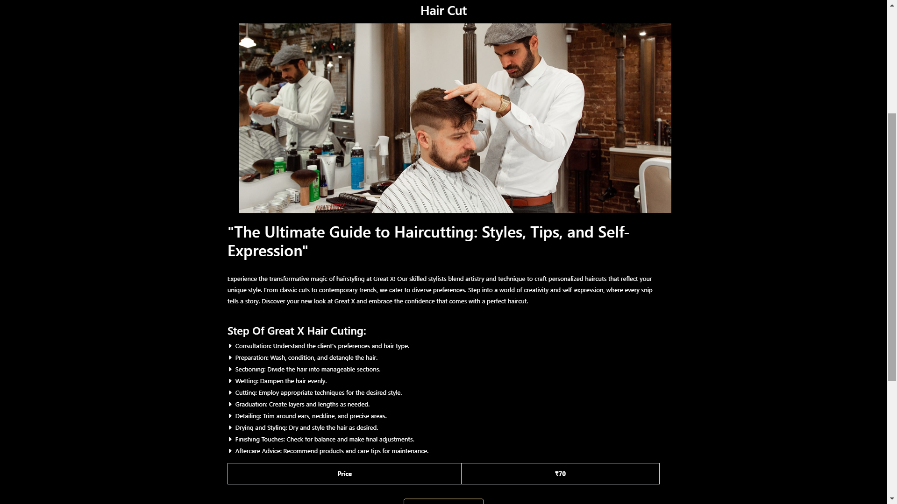
Coman Pages Inside service.

Slide 17
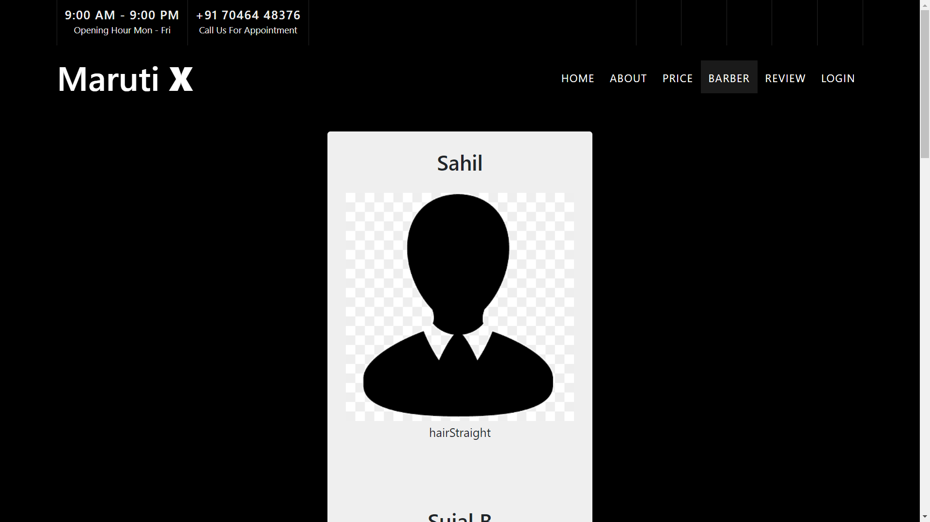
Coman Pages Employee team.

Slide 18
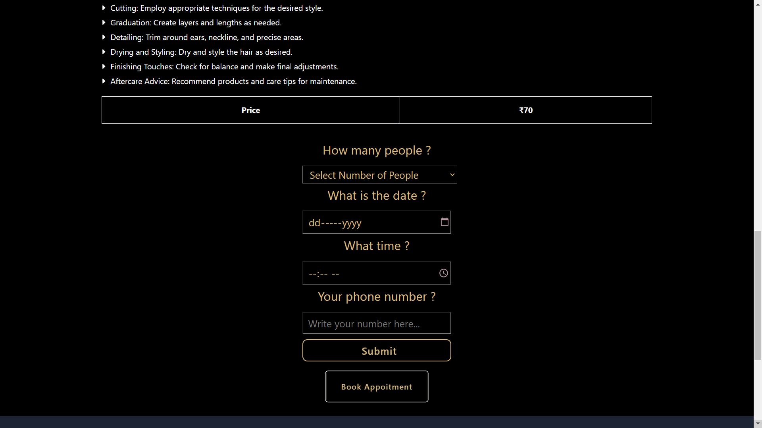
Coman Pages Book appoitment

Slide 19
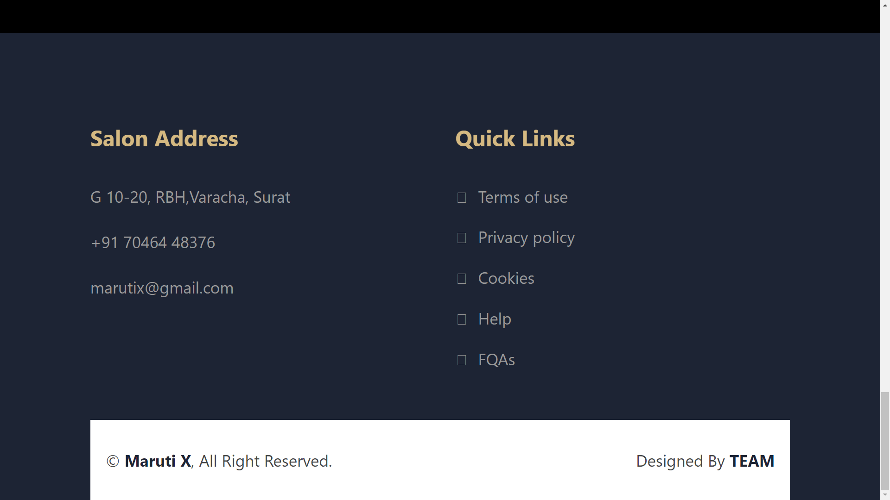
Coman Pages Footer

Slide 20
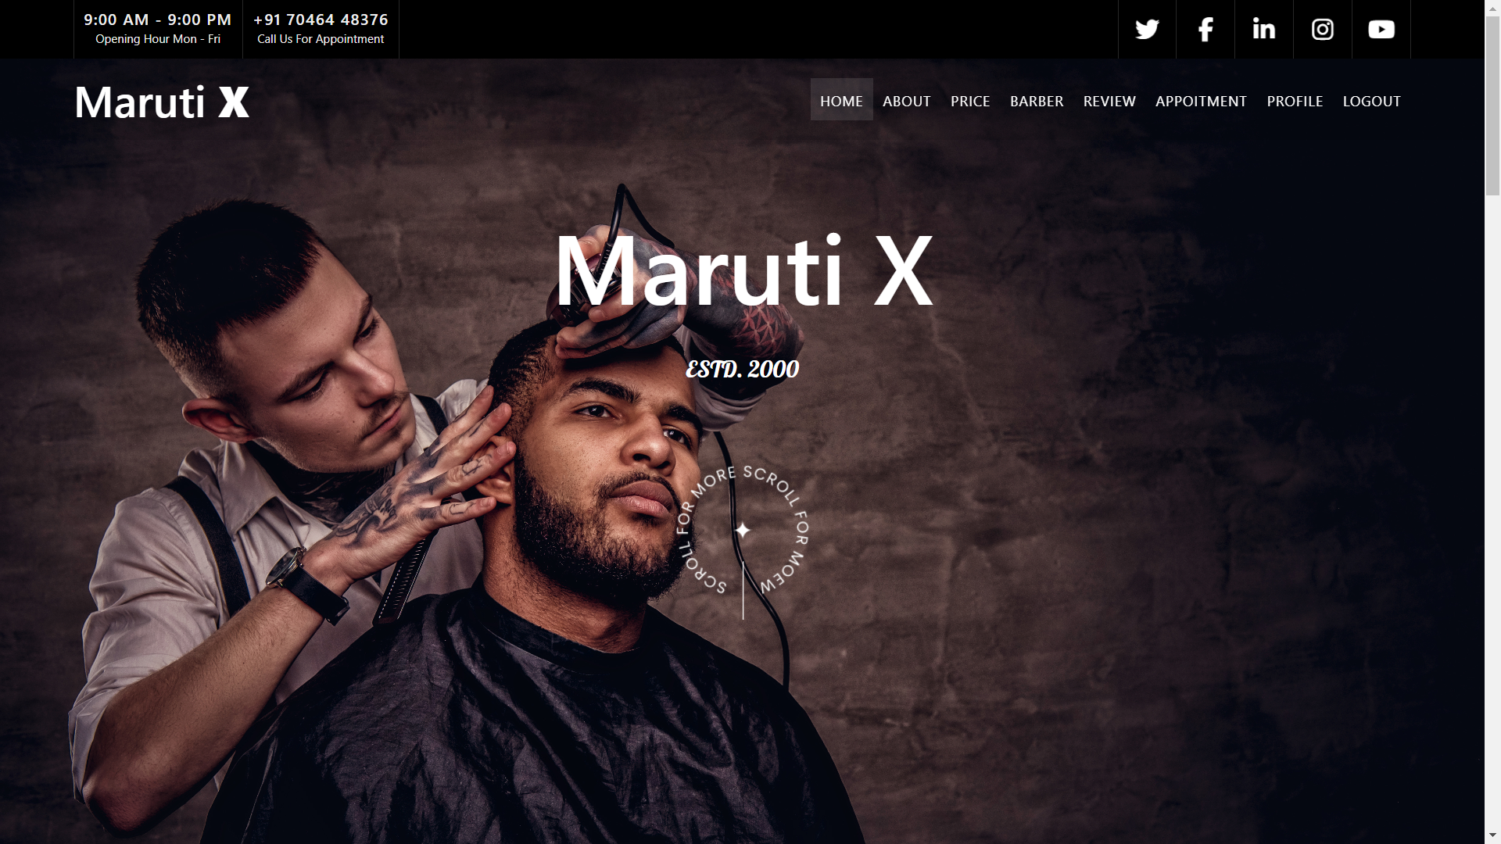
User Side Pages Home

Slide 21
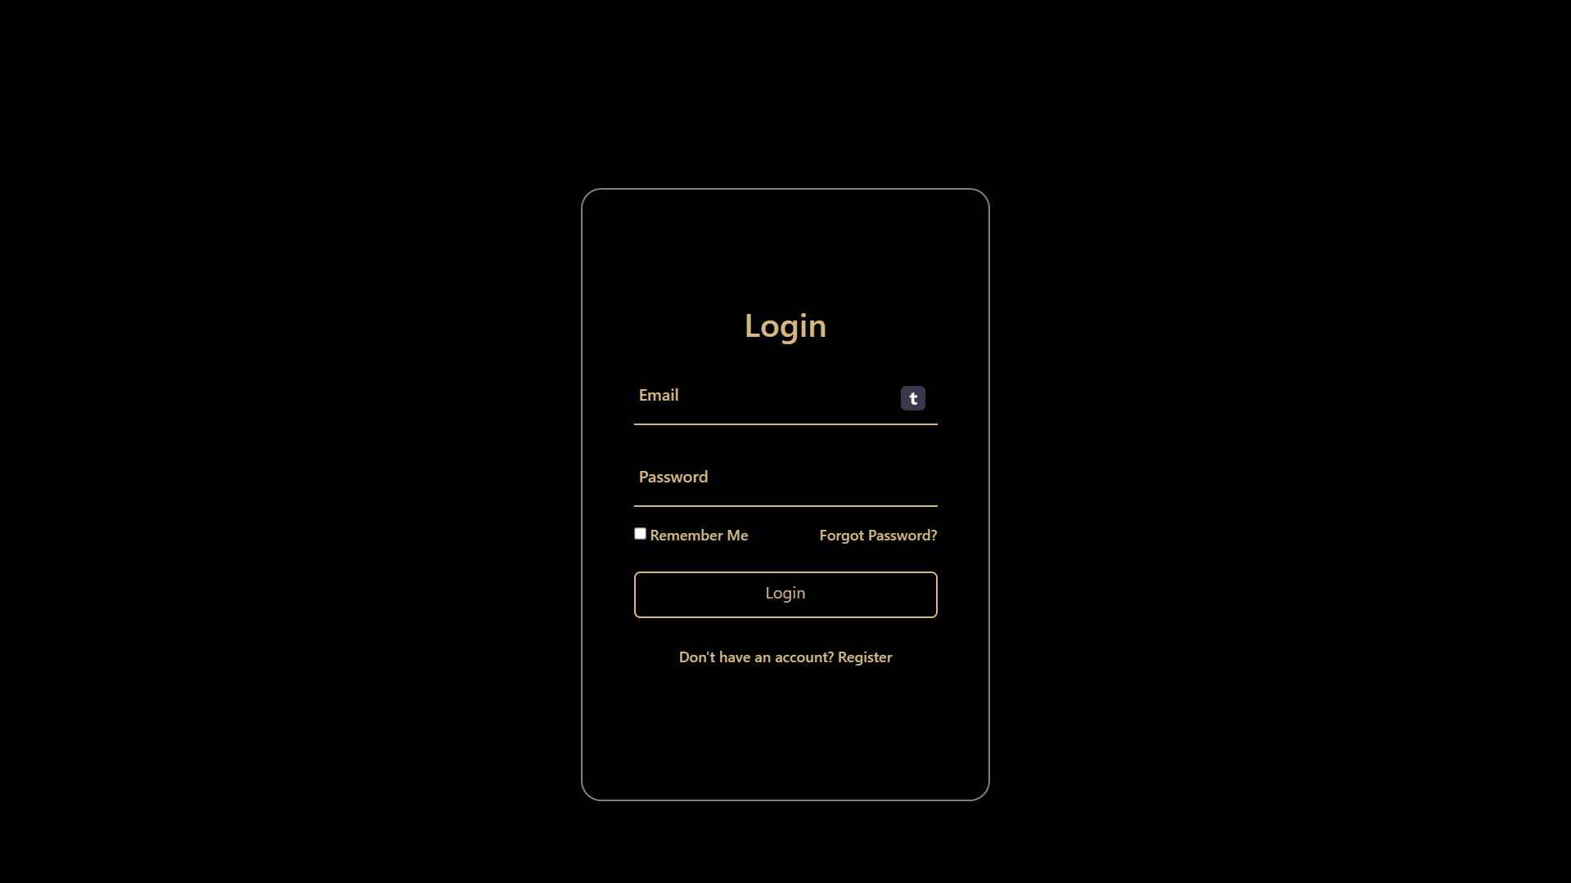
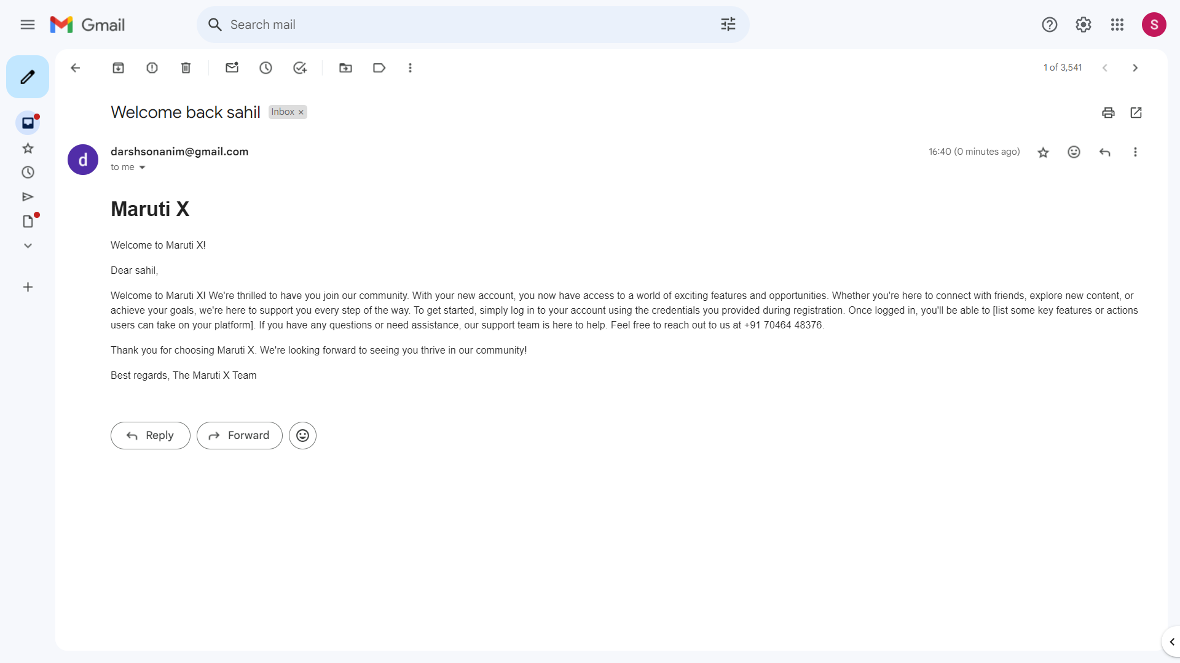
User Side Pages Login page
Login
Email

Slide 22
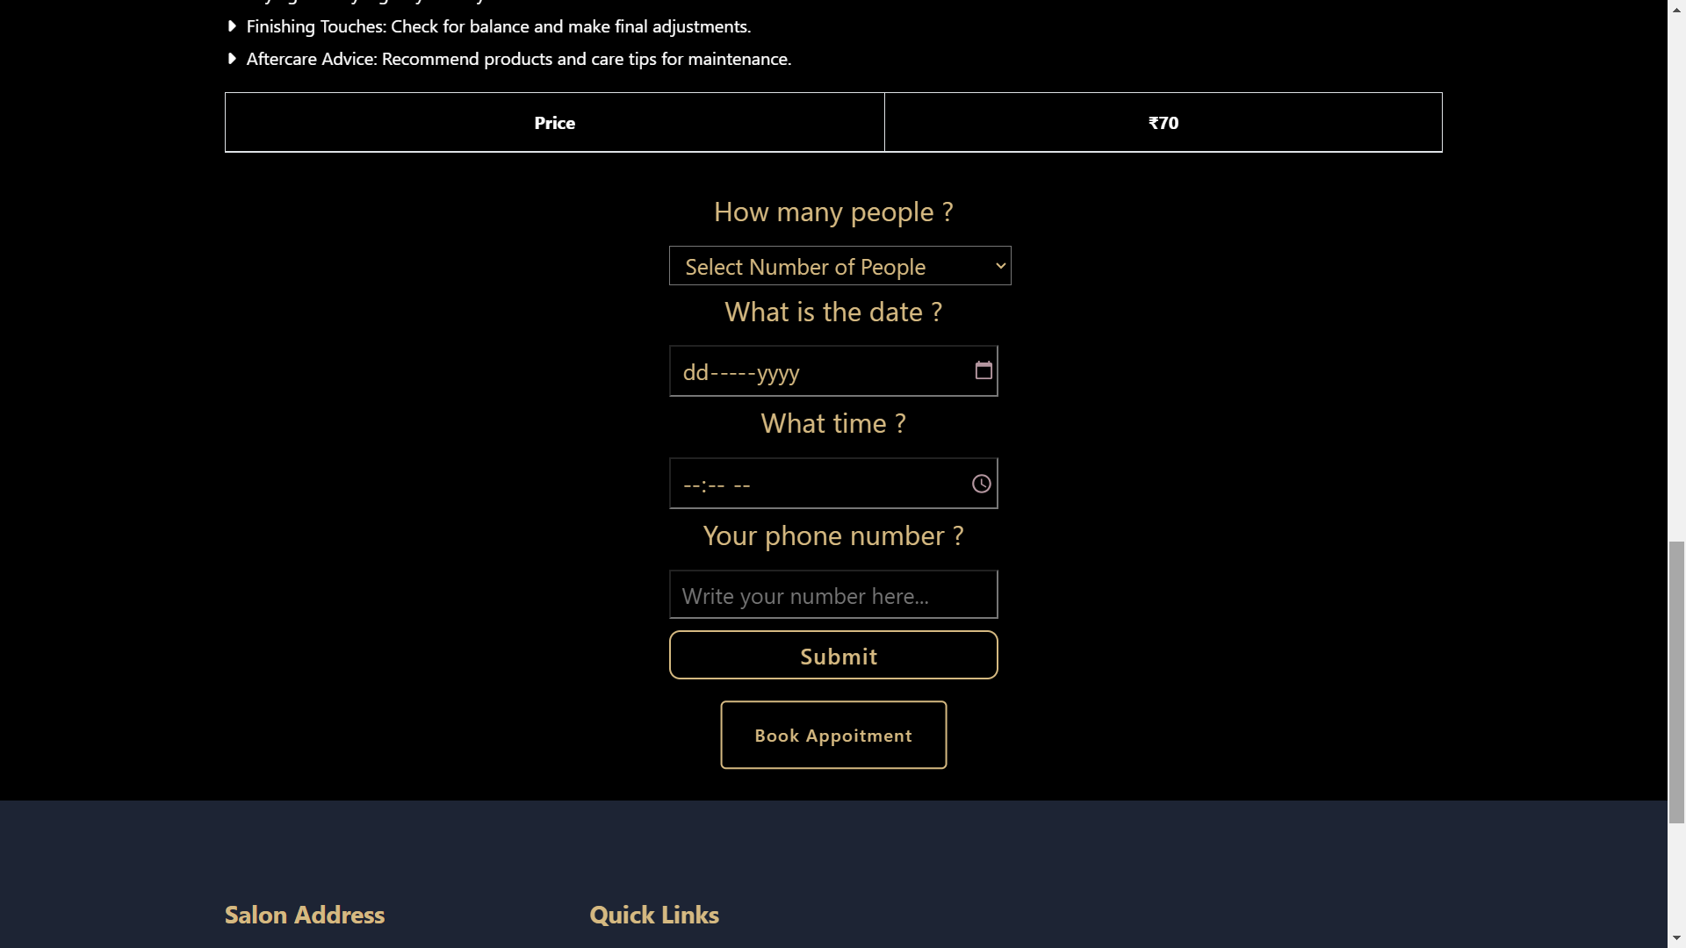
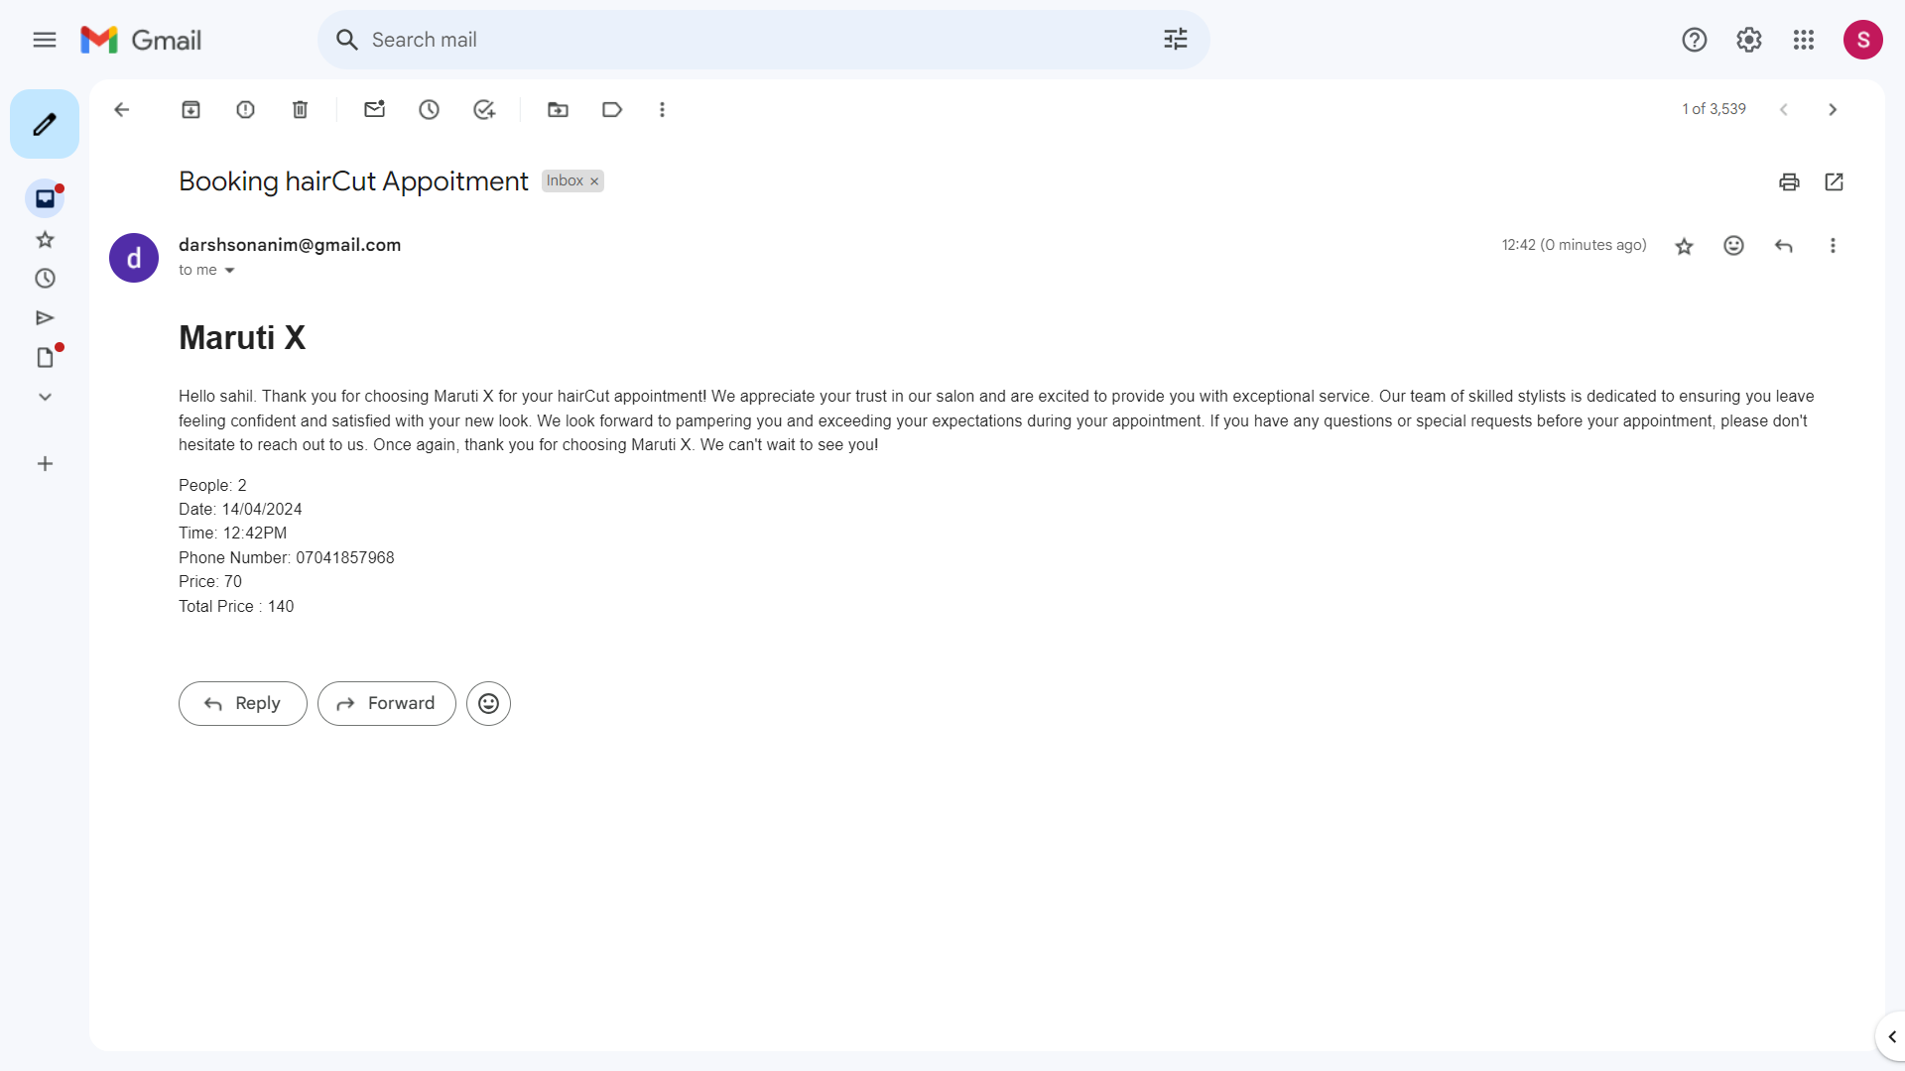
User Side Pages Appoitment Page

Slide 23
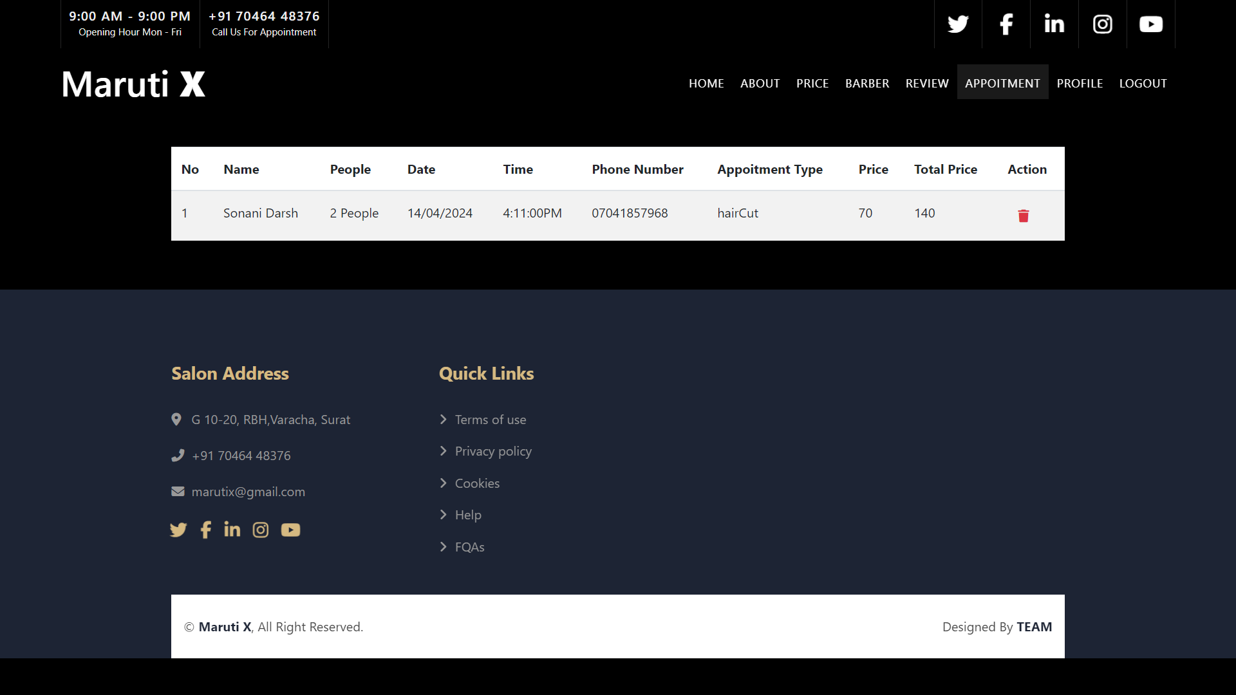
User Side Pages Bookd Appoitment Page

Slide 24


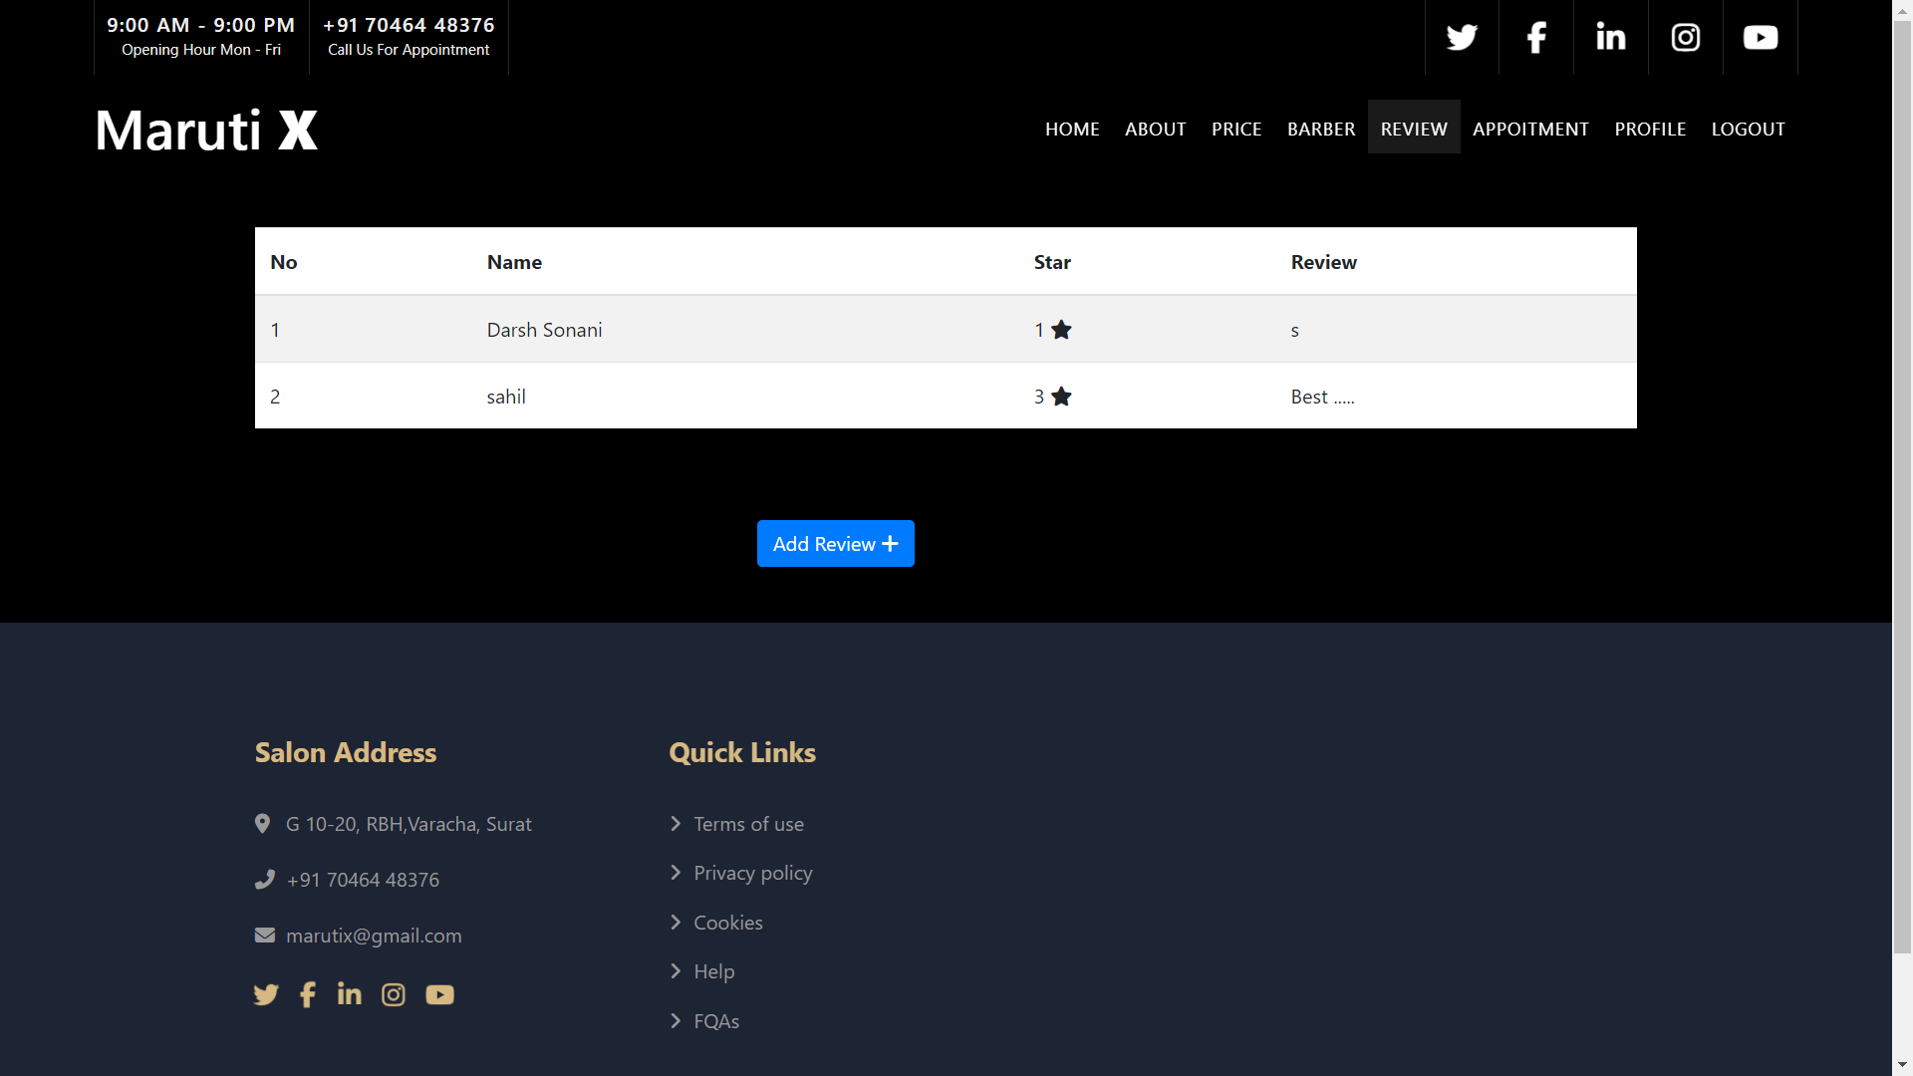
User Side Pages Review Page

Slide 25
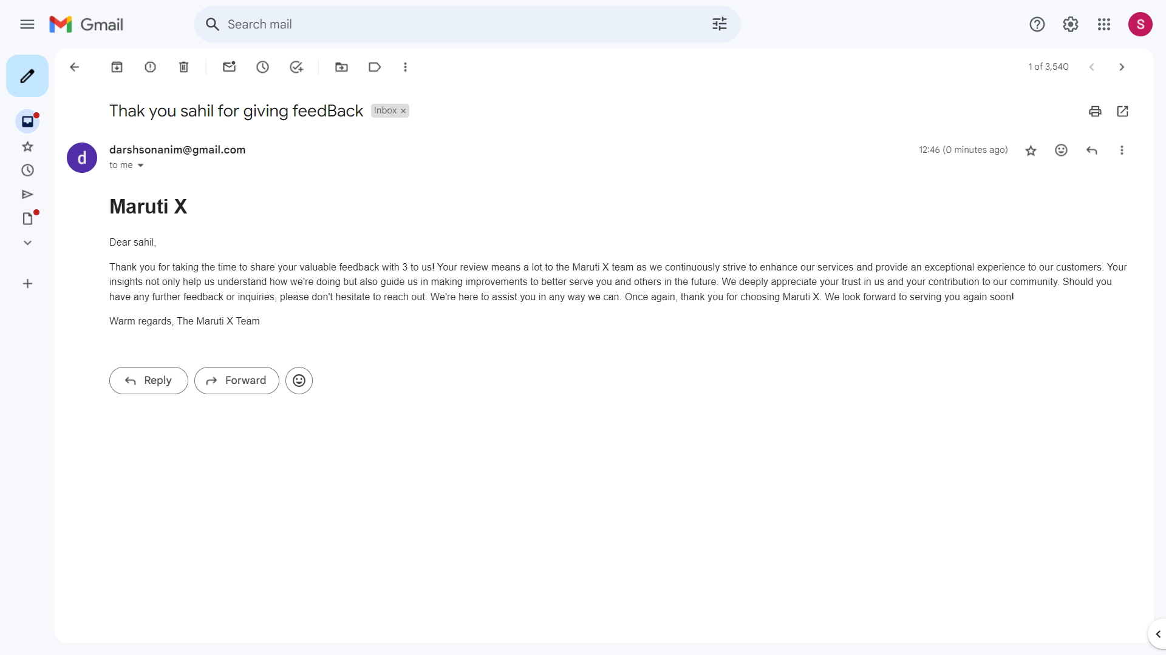
User Side Pages Review Page
Review
Email

Slide 26
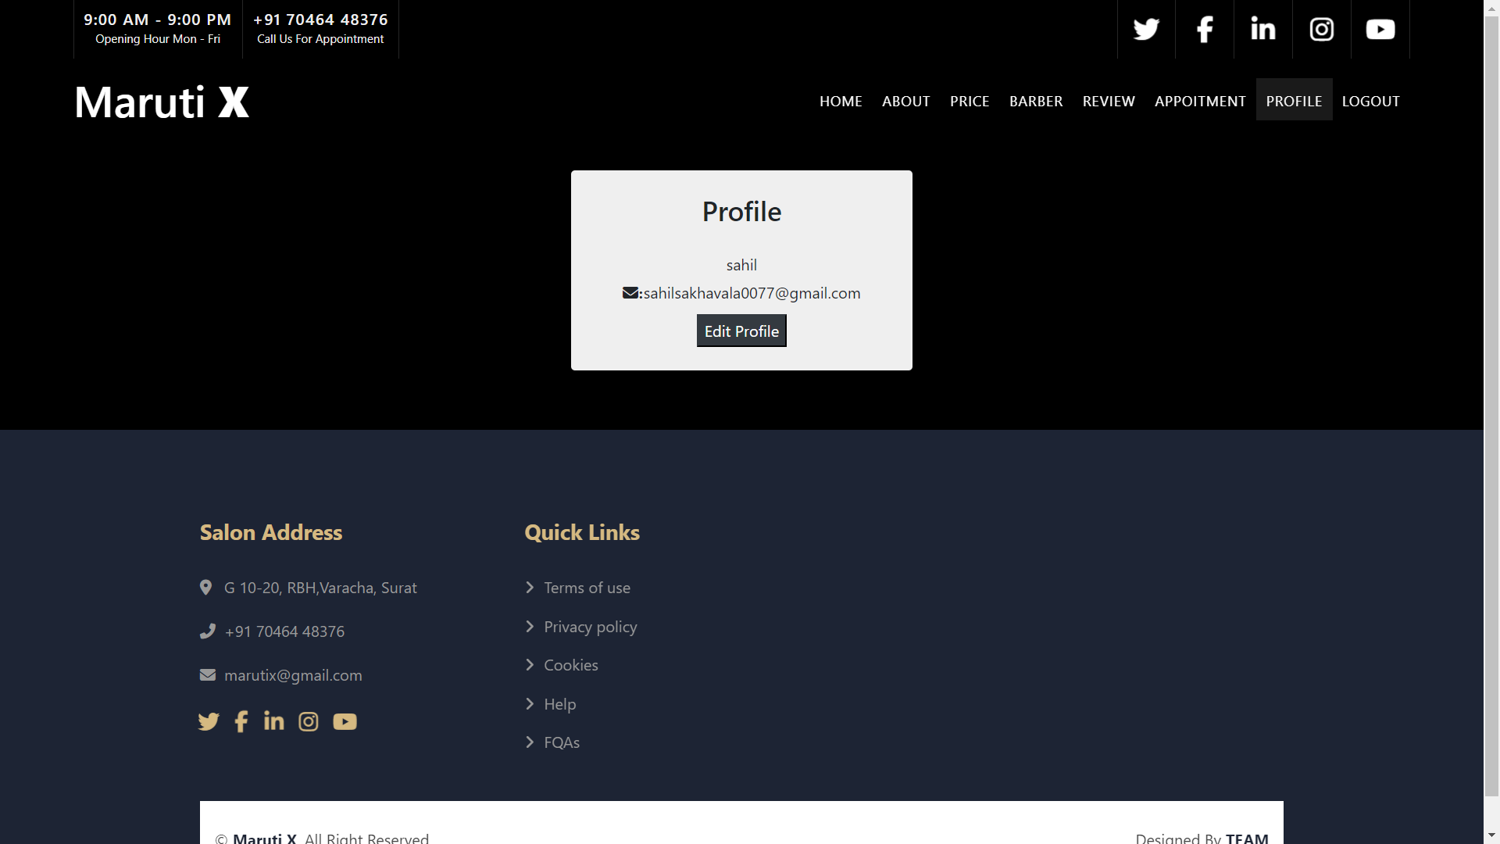
User Side Pages Profile Page

Slide 27
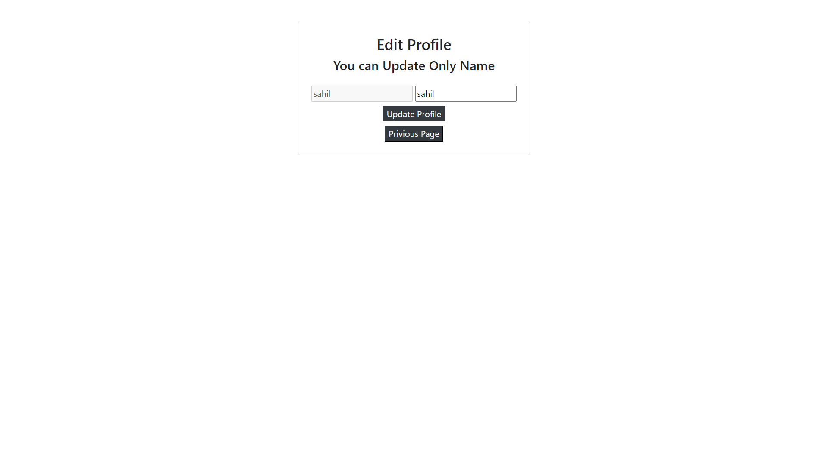
User Side Pages Update Page

Slide 28
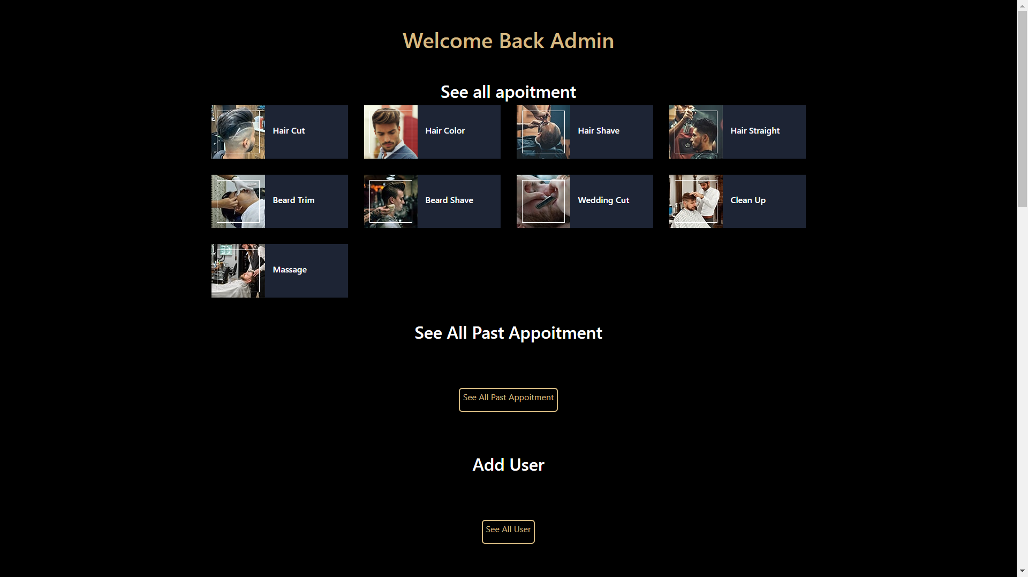
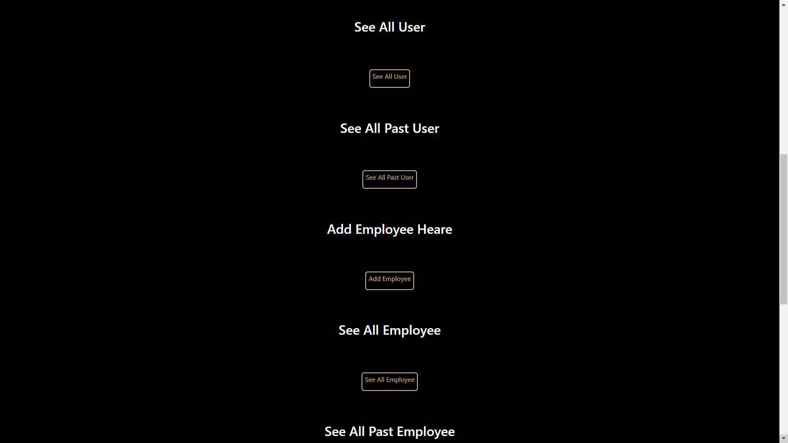
Admin Side Pages Home Page

Slide 29
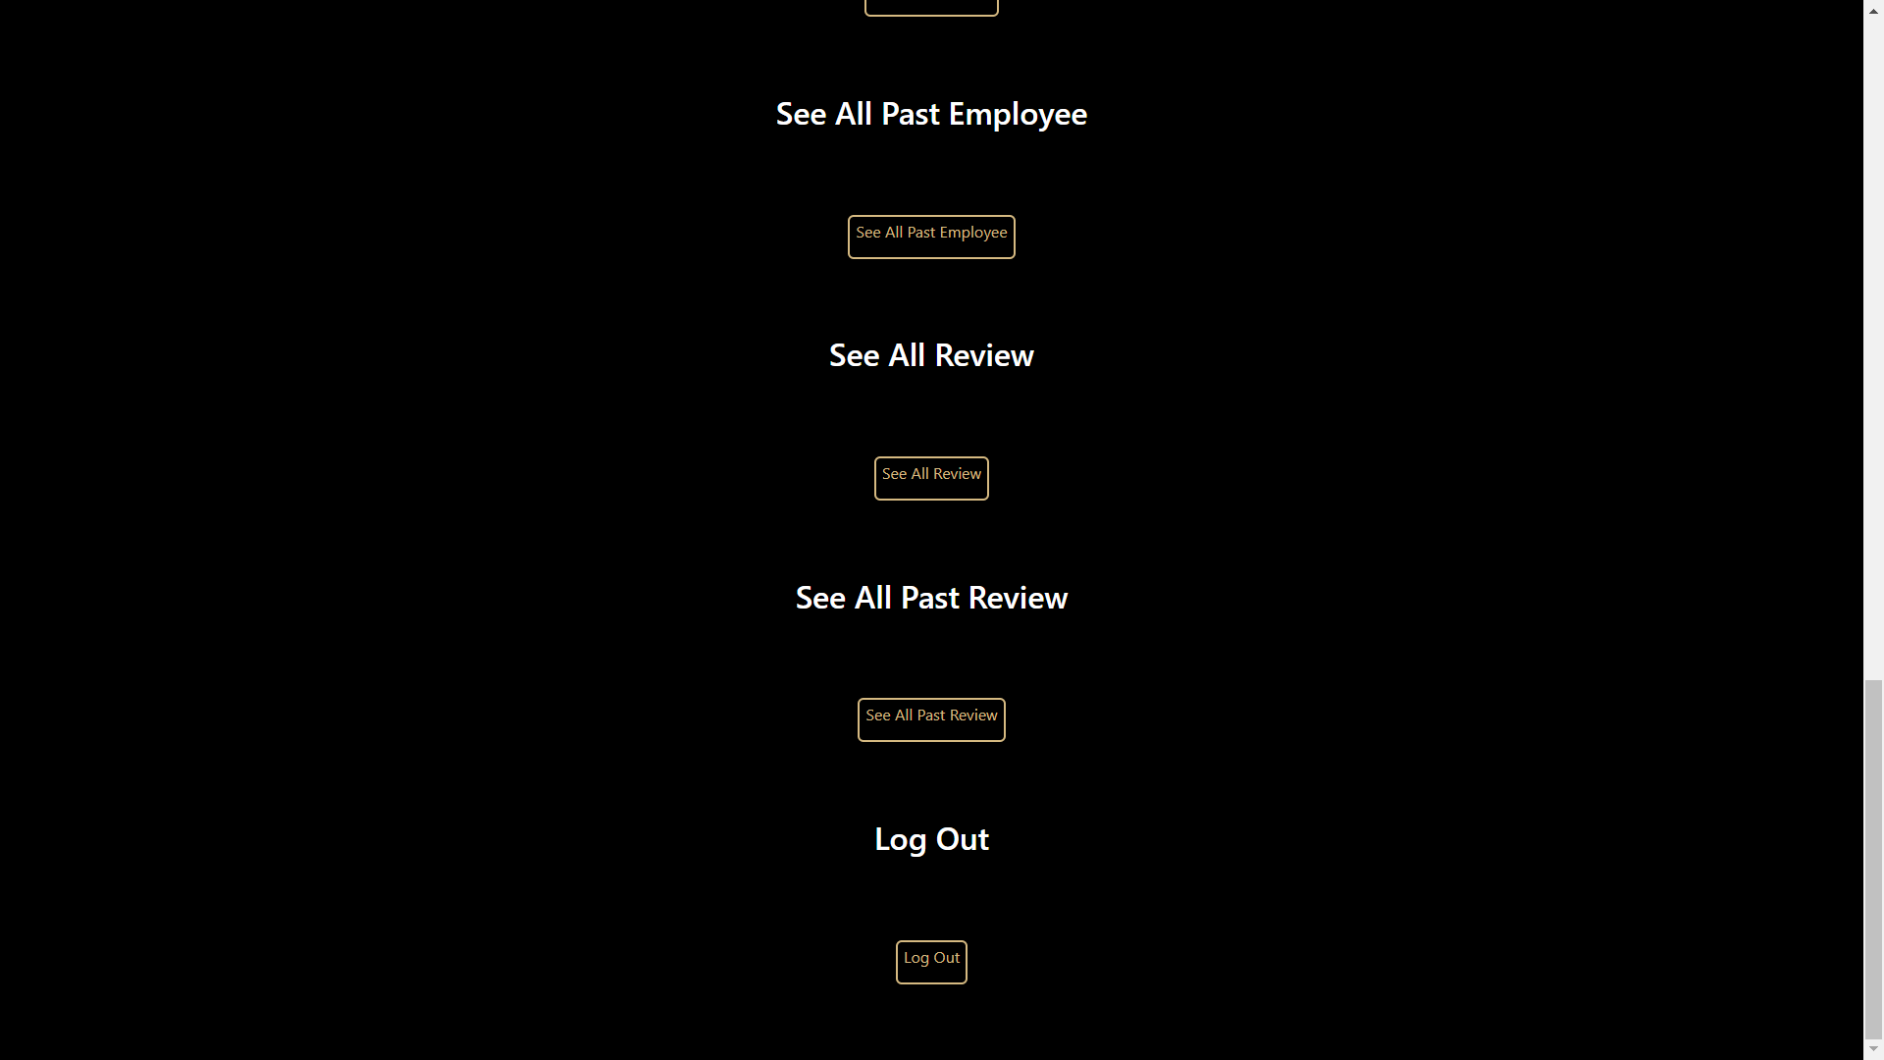
Admin Side Pages Home Page

Slide 30
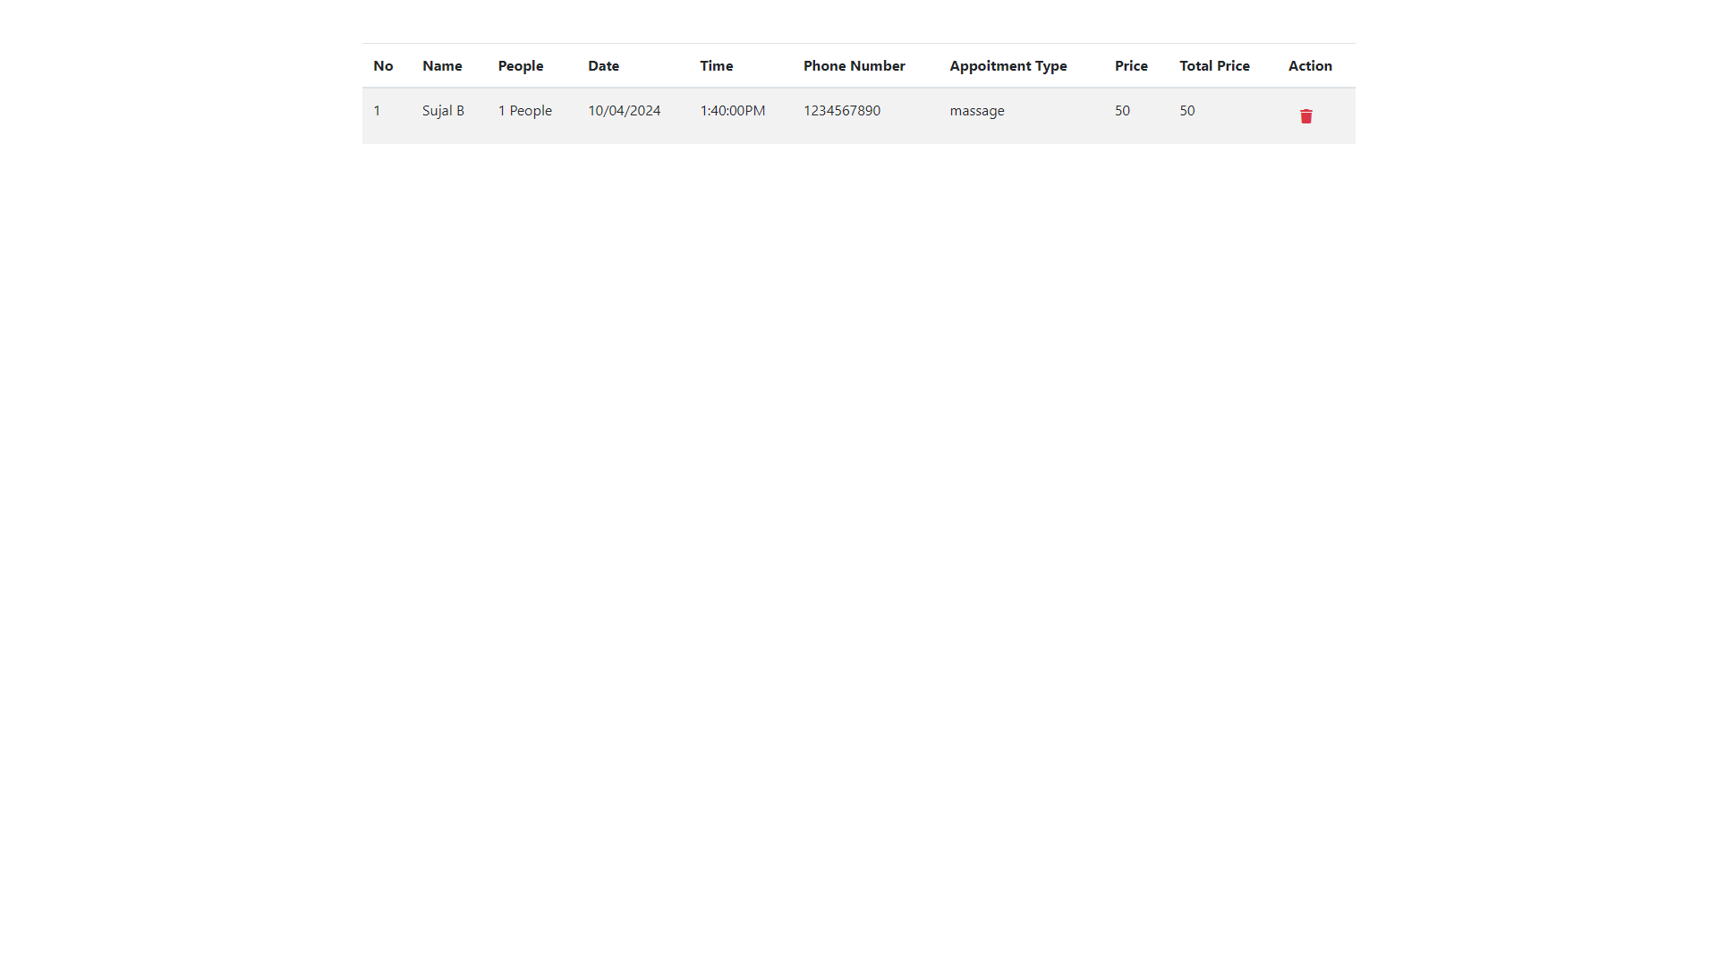
Admin Side Pages Appoitment Page

Slide 31
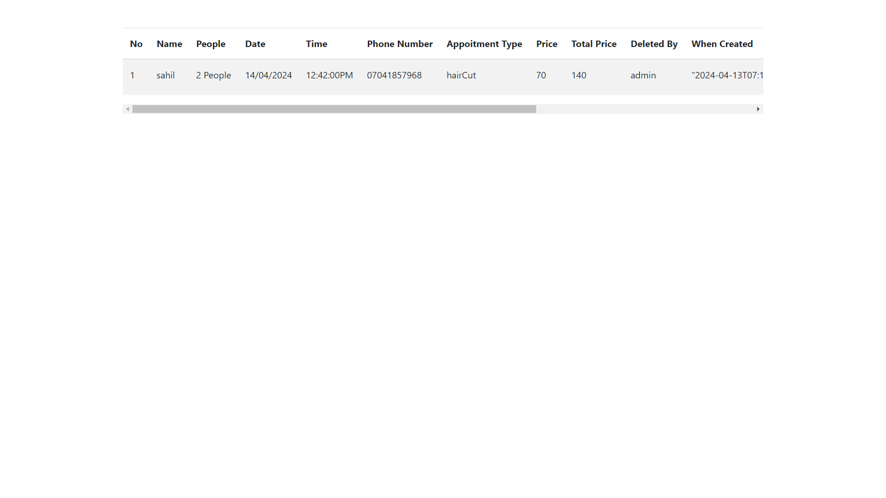
Admin Side Pages Past appoitment Page

Slide 32
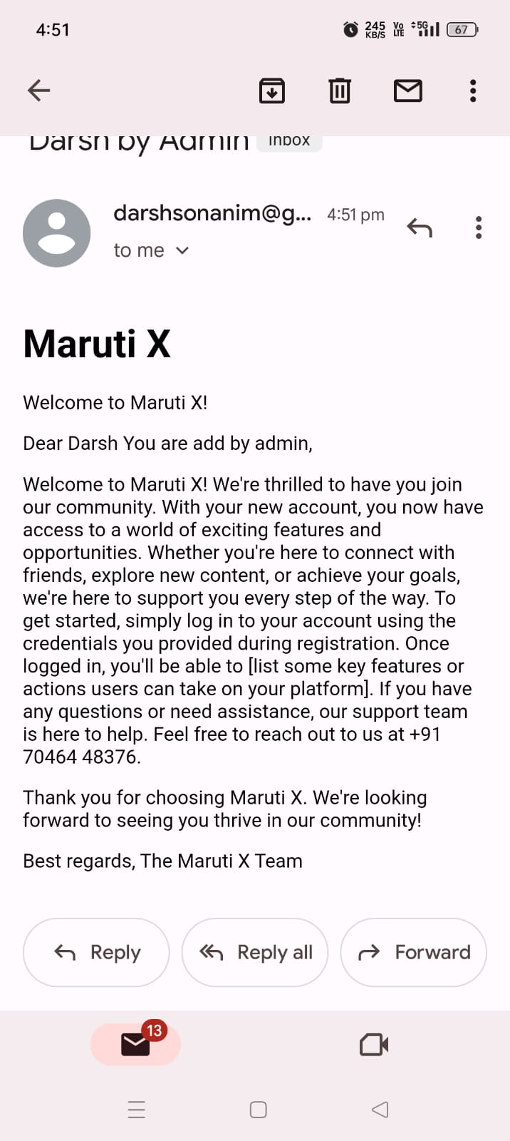
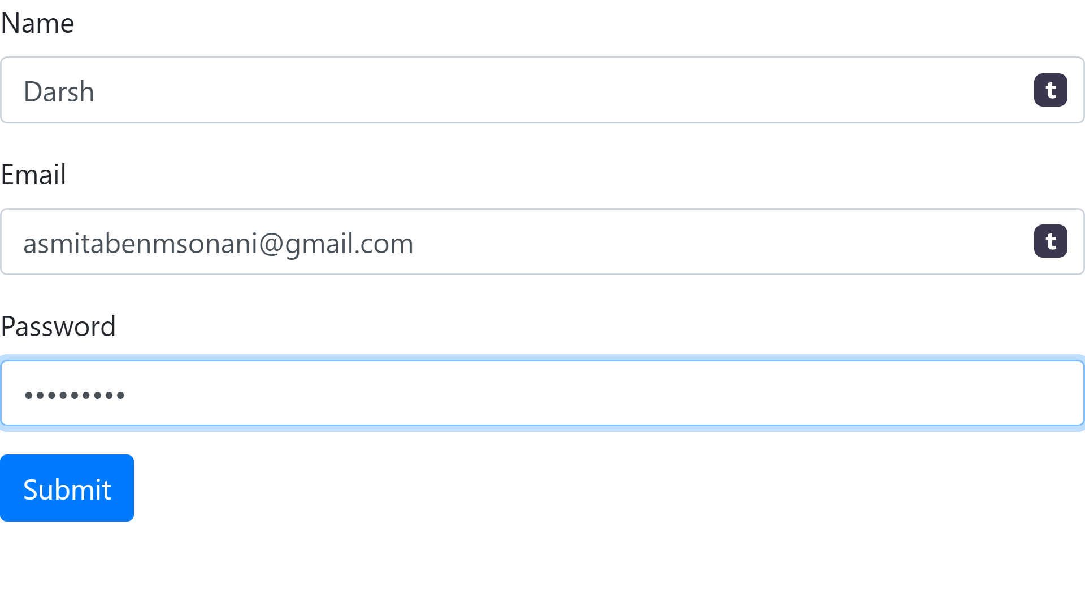
Admin Side Pages Add User Page
Add User
Email

Slide 33
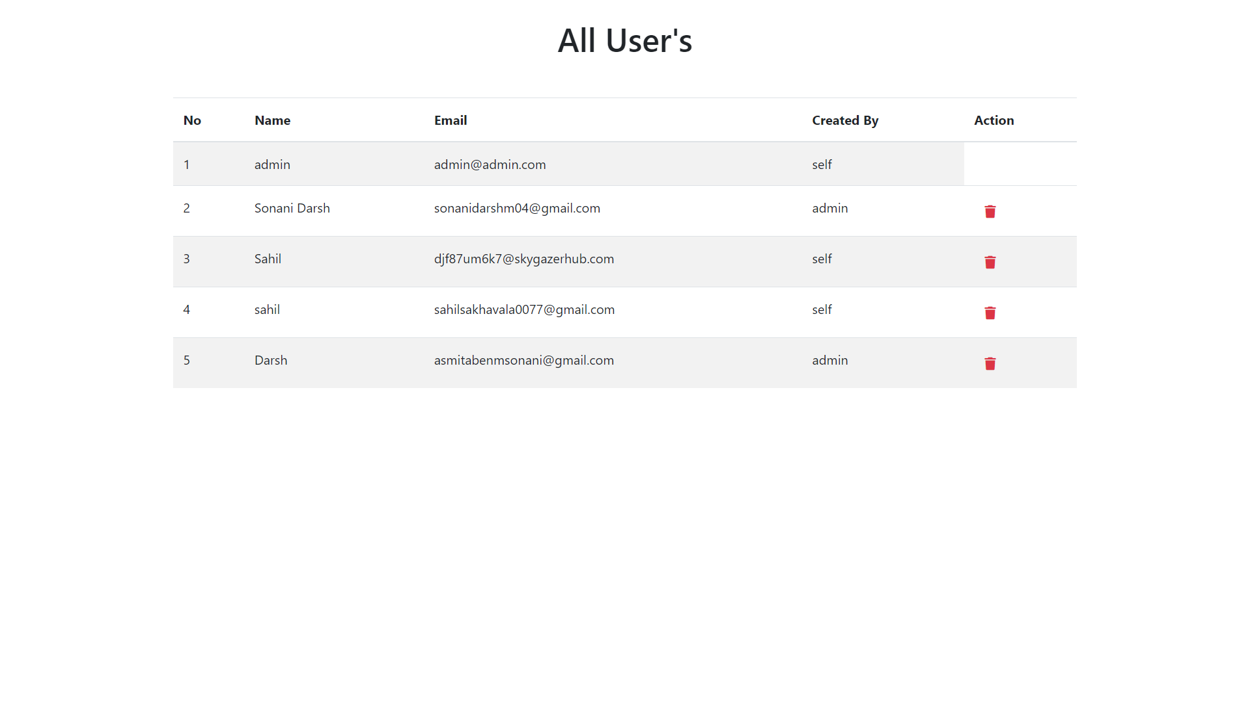
Admin Side Pages See user Page

Slide 34
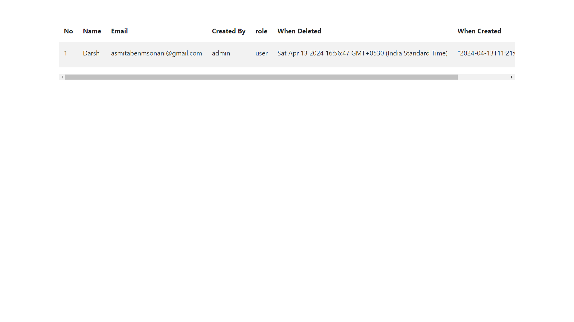
Admin Side Pages See all past user

Slide 35
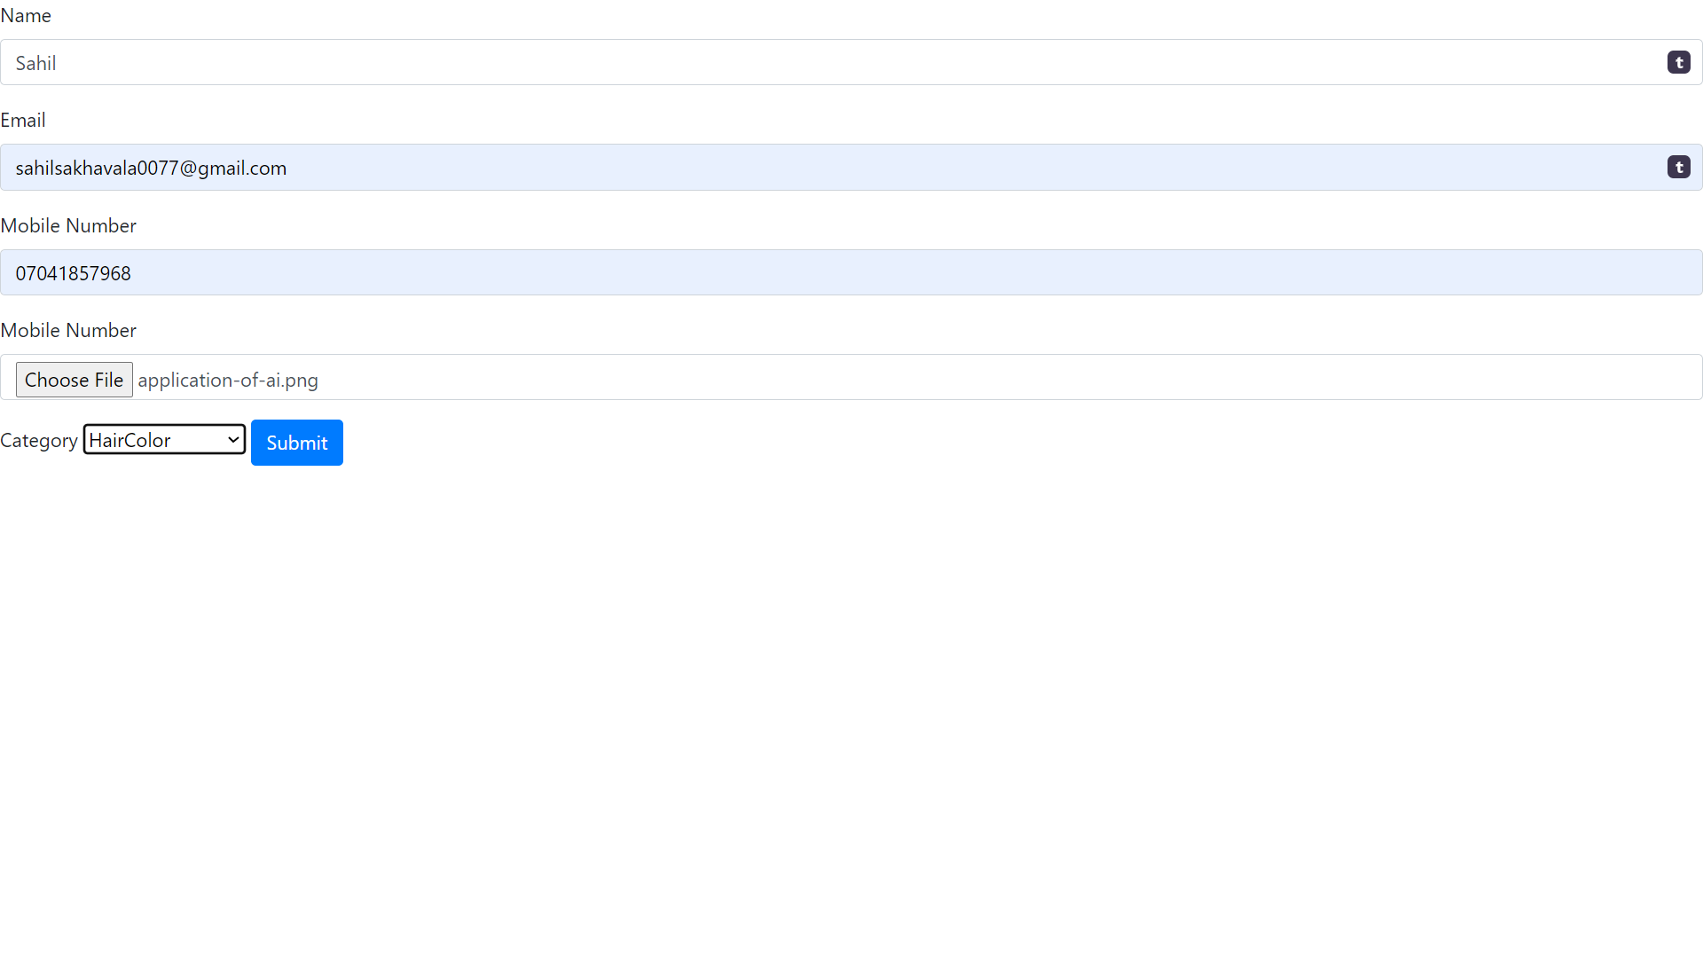
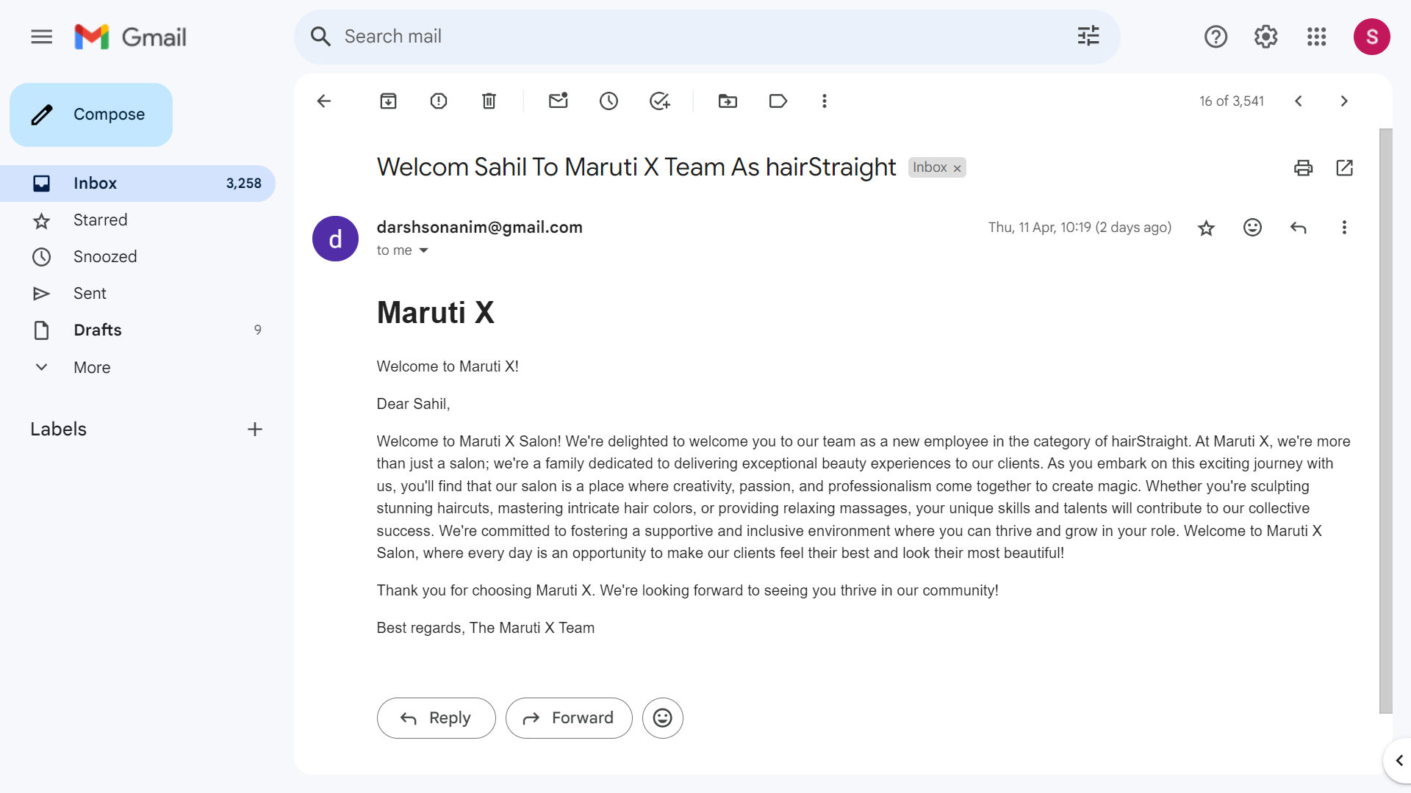
Admin Side Pages Add Employee
Form
Email

Slide 36
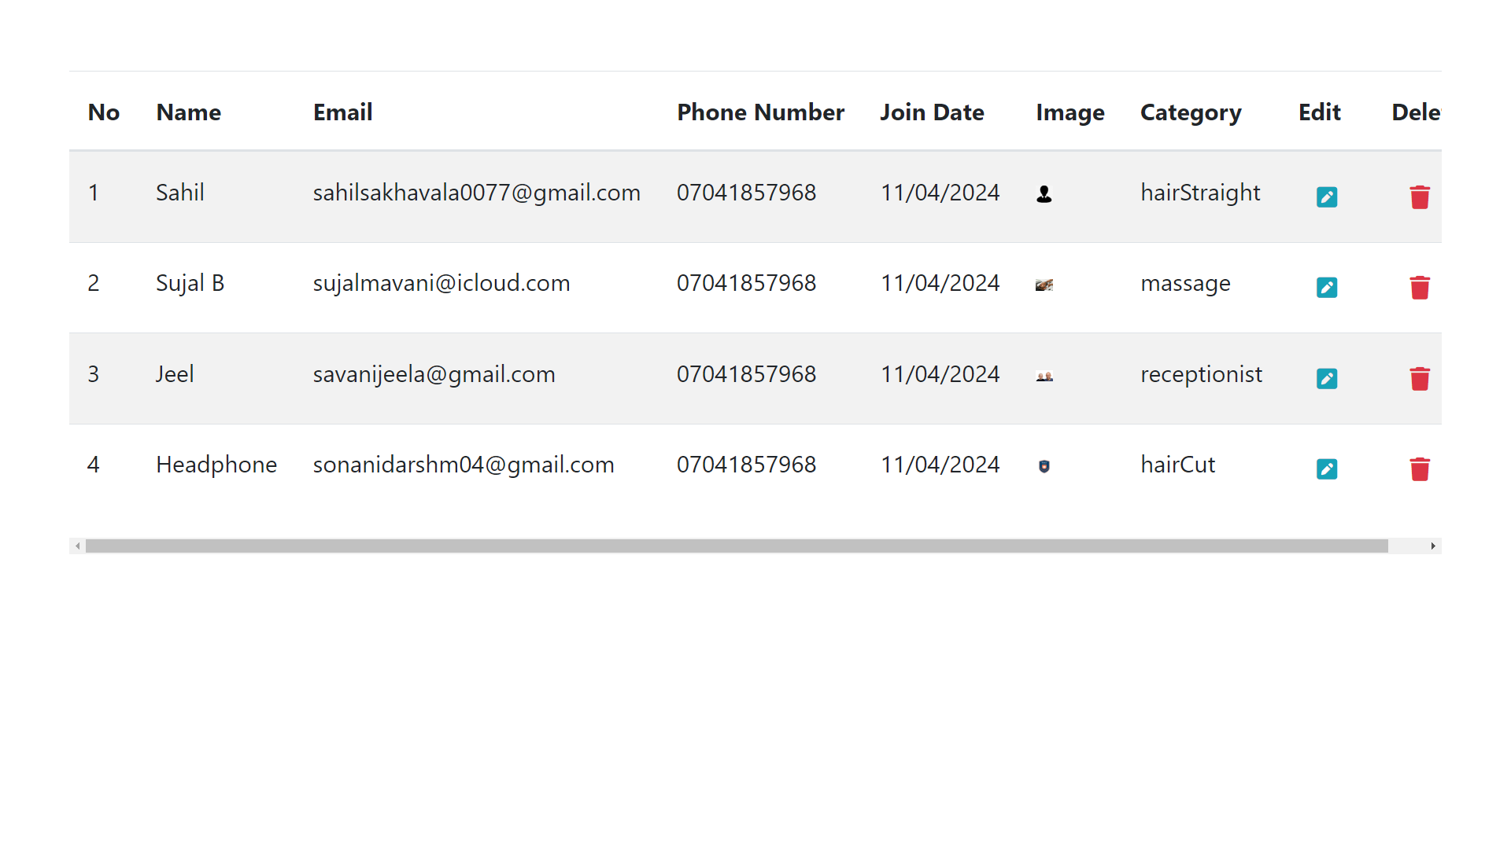
Admin Side Pages See all employee

Slide 37
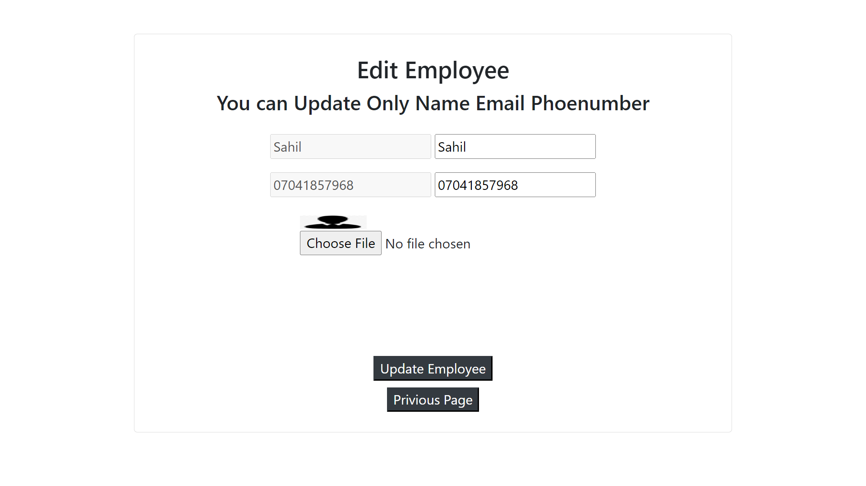
Admin Side Pages Edit employee

Slide 38
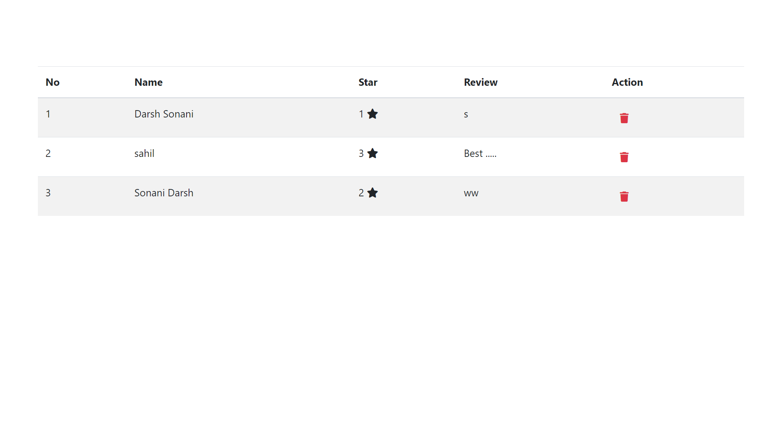
Admin Side Pages See All Review

Slide 39

Admin Side Pages Admin Log out

Slide 40
Limitation
The online payment system is not implemented so that only ofline payment is possible.
System only manage Service and Book Appoitment.

Slide 41
Future Enhancement Of Project
We are going to enhance the paypal system for online transaction. so that customer has no worried about the payment system he has just information about the credit card and electronic payment cards.
We are going to enhance/implement beuaty product in our site.and create salon service page.

Slide 42
Refrence
https://www.npmjs.com
http://www.stackoverflow.com
https://developer.mozilla.org/en-US/
https://www.freepik.com/
https://www.w3schools.com/html/
https://www.w3schools.com/css/
https://www.w3schools.com/js/
https://www.w3schools.com/nodejs/
https://ejs.co/
https://www.npmjs.com/package/multer
https://sequelize.org/
https://getbootstrap.com/

Slide 43
Thank You

